Slide 1
Correlation

Slide 2
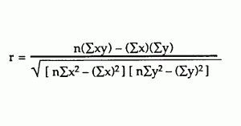
Correlation
Correlation coefficient is an equation that is used to determine the strength of relation between two variables.
Correlation coefficient sometimes called as cross correlation coefficient. Correlation coefficient always lies between -1 to +1
where -1 represents X and Y are negatively correlated and
+1 represents X and Y are positively correlated.
0 means there is no correlation

Slide 3
Correlation
Each data point in the dataset is an observation, and the features are the properties or attributes of those observations.
Every dataset you work with uses variables and observations.
For example, you might be interested in understanding the following:
  How the height of basketball players is correlated to their shooting accuracy
  Whether there’s a relationship between employee work experience and salary
  In the examples above, the height, shooting accuracy, years of experience, salary, population density, and gross domestic product are the features or variables. The data related to each player, employee, and each country are the observations.

Slide 4
Correlation
 | x | y |  | x*y | x*x | y*y
 | 15 | 25 |  | 375 | 225 | 625
 | 18 | 25 |  | 450 | 324 | 625
 | 21 | 27 |  | 567 | 441 | 729
 | 24 | 31 |  | 744 | 576 | 961
 | 27 | 32 |  | 864 | 729 | 1024
Sum | 105 | 140 |  | 3000 | 2295 | 3964
Sum | x | y |  | x*y | x*x | y*y
Corrélation coefficient
= (5 * 3000 - 105 * 140)
/ sqrt((5 * 2295 - 1052)*(5*3964 - 1402))
= 300 / sqrt(450 * 220) = 0.953463
Corrélation coefficient = 0.953463

Slide 5
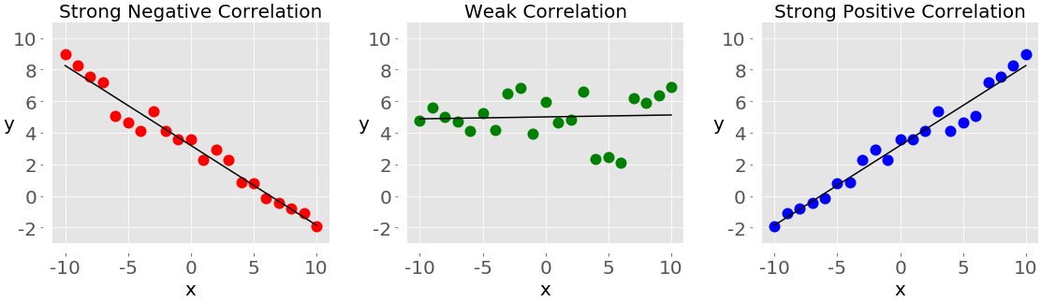
Correlation

Slide 6
Correlation does not imply causation
Correlation is not causation

Slide 7
End

